Slide 1
System Development (COMP 1713) System Requirements Requirements Elicitation
Dr. Simon Scola
With major thanks to Ing. Alexander M. Fedorec for the wonderful slides
Along side various other CIS staff

Slide 2
This Week
A quick reminder of previous topics
Discuss decomposition and abstraction of what we are to build (product) and how we are going to build it (process) - both start with understanding requirements
Requirements gathering (elicitation)
Techniques for fact-finding
Requirements analysis
Understanding functional and non-functional requirements
Requirements specification
documenting the results of elicitation and analysis

Slide 3
Review - How do we address the problems of Systems Development?
Dealing with complexity:
Decomposition – divide the problem into smaller ‘brain-sized’ chunks
Abstraction – concentrating on the most important elements while ignoring currently irrelevant details
Iteration – redefine the problem and repeat decomposition and abstraction
We can decompose and abstract
the product (what we are building)
the process (how we are building it)

Slide 4
Decomposition and Abstraction of the Development PRODUCT
Break the product down into components or sub-systems based on different factors such as:
What the system does – behaviour and functionality
What information is being held, processed and transformed
Deployment – which physical parts of the system are responsible for doing what and talking to who
Bearing in mind you are decomposing and abstracting the product to make it easier to build, what other ways are there of decomposing a system?
Exercise: What are the components of an online shopping system?

Slide 5
Abstraction and Decomposition of the Development PROCESS from last week
The problem: So what is the 'develop system’ ?
Develop System
requirements
Software System

Slide 6
Abstraction and Decomposition of the Development PROCESS from last week
An initial decomposition
Customer’s Requirements
Collect and understand customer requirements
Develop System
Software System
Note: We are defining the process of
system development more clearly
through decomposition

Slide 7
Abstraction and Decomposition of the Development PROCESS from last week
Good systems are ones which meet the customer’s stated or implied needs and requirements
How do we build good systems?
Collecting and specifying the requirements is called ‘Requirements Engineering’
Note: requirements need to be specified in a way that we can check if the delivered system meets them.
Note very high level of abstraction
Collect and specify the requirements
Build System
Check what we have built meets requirements
System
System Development version 2
3
Note decomposition of process

Slide 8
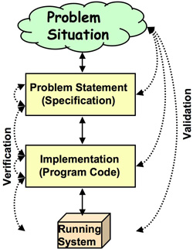
Verification and Validation
The terms Verification and Validation are commonly used in software engineering to mean two different types of analysis.
The usual definitions are:
Validation: Are we building the right system?
Verification: Are we building the system right?
From: http://www.easterbrook.ca/steve/2010/11/the-difference-between-verification-and-validation/

Slide 9
This Week Requirements
“The hardest single part of building a software system is deciding what to build. No part of the work so cripples the resulting system if done wrong. No other part is more difficult to rectify later”
Fred Brookes Jnr

Slide 10
What is a Requirement?
A condition or capability
Needed by the user to solve a problem or achieve an objective
That must be met by a system or system component to satisfy a contract, standard, specification or other formally imposed document.
That must be met or possessed by a system, product, service, result, or component to satisfy a contract, standard, specification, or other formally imposed document. Requirements include the quantified and documented needs, wants, and expectations of the sponsor, customer, and other stakeholders
A documented representation of a condition or capability as in (1) or (2).
International Standard ISO/IEC/IEEE 24765:2010 Systems and Software Engineering — Vocabulary
Supersedes IEEE 610.12-1990 - IEEE Standard Glossary of Software Engineering Terminology

Slide 11
Aim of Requirements Engineering
The requirements engineering process is a structured set of activities which lead to the production of a requirements specification document in sufficient detail that it can be used to design and implement a system and validate the delivered system
Requirements engineering processes vary radically from one organization to another.
Most processes include
requirements elicitation, requirements analysis and
negotiation, specification and validation.
Definition taken from Sheldon, F.T., Requirements Engineering, http://www.csm.ornl.gov/~sheldon/cs531/ch2.pdf Adapted from Requirements Engineering Processes and Techniques by G. Kotonya and I. Sommerville 1998

Slide 12
What Requirements?
Depends on our terms of reference and the nature of the solution
This could be
What software do we need to write
What hardware and comms do we need
What support processes do we need
What security and where?
…

Slide 13
What Requirements? Requirements Engineering as the first step in defining the Solution Architecture
Enterprise Architecture
Business Architecture
Solution Architecture
Information System Architecture
Application / Software Architecture
Information / Data Architecture
Infrastructure / Technical Architecture

Slide 14
Requirements Engineering
Can we break the requirements process into smaller steps?
Identify and talk to stakeholders, Collect their requirements
Identify the stakeholder’s drivers and concerns
What are their requirements? What are their goals? What do they need to achieve?
Are there any constraints or principles that the solution must take account of?
Analyse the requirements:
Are some more important than others? Can some be left to later?
Are the requirements clear and unambiguous?
Are they complete? Are there any gaps?
Resolve any conflicts or inconsistencies.
Document the requirements in a form that
can be translated into a design
and that can be used to check the delivered system

Slide 15
Requirement Engineering
Requirements Elicitation (from the client/stakeholders)
Understand the existing situation (the baseline as-is system)
Must determine what a client needs
Identifying/capture requirements
Requirements Analysis
Determine what is needed to meet the client’s needs
Specification (to the developer/tester/maintainer)
Define requirements for the new system (the target to-be system)
Describe using an appropriate language/notation, e.g. UML, ERD
Notes:
15

Slide 16
Requirements Engineering
Inception
Requirements Elicitation
Requirements Analysis
Elaboration, Negotiation
Requirements Specification
Documenting Functional Requirements
Non-functional Requirements
Requirements Validation
Requirements Management
Notes on inception, validation and management are included in this set of slides for completeness but an understanding is not needed at this level and we will skip through them today.

Slide 17
Requirements Engineering is Iterative
Requirements analysis and
specification
System requirements specification and
modelling
User requirements specification
Business requirements specification
System requirements elicitation
Identify next-level
stakeholders
Feasibility Study
User requirements elicitation
Prototyping
Requirements elicitation
Reviews
Requirements validation
System requirements document

Slide 18
Requirements Engineering
Inception
Requirements Elicitation
Requirements Analysis
Requirements Specification
Requirements Validation
Requirements Management

Slide 19
Project Inception
Inception
How does the project start?
If projects are not to spiral out of control they need a clear start with problem definition and terms of reference
Inception is when responsibilities are allocated and resources are first committed to the project
Inception may start with a request for tender, a formal proposal or simply your manager asking you to take on the project.
May require a feasibility study to evaluate the prospects for success before committing major resources

Slide 20
Inception - Feasibility Studies
Inception
If there is uncertainty about whether or not the proposed system is worthwhile you may conduct a feasibility study before committing resources.
A feasibility study is short focused study that aims to assess the potential cost required and value to be attained
Typically will examine: (TELOS)
Technical feasibility
Economic, financial, market…
Legal
Operational will satisfy requirements, fit in with current systems…?
Schedule – can it be done in time?

Slide 21
Feasibility Study Cont’d
Inception
Questions to consider:
What if the system wasn’t implemented?
What are current process problems?
How will the proposed system help?
What will be the integration problems?
Is new technology needed? What skills?
What facilities must be supported by the proposed system?

Slide 22
Development Practices
Inception
Feasibility Study should consider development approach
Bespoke vs. Commercial-Off-The-Shelf (COTS) (buy, build or subcontract?)
Implementation: Big Bang, Pilot, Phased, Parallel…
These and other issues will be discussed in other courses – we will focus on building systems

Slide 23
Requirements Engineering –Cont’d
Inception
Requirements Elicitation
Requirements Analysis
Requirements Specification
Requirements Validation
Requirements Management

Slide 24
Requirements Elicitation
Requirements Elicitation
Also called
Requirements capture
Requirements gathering
Requirements acquisition
Requirements discovery

Slide 25
Elicitation
Requirements Elicitation
Involves working with the customer and other stakeholders to find out about
the application domain and the current system,
the services that the new system should provide and the system’s operational constraints.
Note: Requirements implicitly starts with identifying and prioritising stakeholders and their needs – many system failures are due to failure to correctly identify the stakeholders.

Slide 26
Requirements Elicitation
Requirements Elicitation
It is difficult to capture requirements because
The Customer:
May not know what they require
May not know what they can get
Many roles/departments in the customer organisation may require different things
e.g. College: lecturers, registry, finance all have different requirements from a student record system
The Analyst:
May not know anything about the business
May know too much about the business
Different views
Different roles / interests / “hats”

Slide 27
What Information to Gather
Need to gain a full picture of the current system and the application domain
So that we deliver a solution that fits in with what the users do and how they do it
Need to gather information on changes required to current functions and data to support goals of target system.
Exceptions
Rules & Exceptions
Facts & Opinions
Documentation
Current System
Opportunities & Threats
Processes & Procedures
Strengths & Weaknesses
Work Distribution
Problems
Volumes & Timings

Slide 28
Levels of Organisation
For information and discussion only
Different levels of an organization need different types of information therefore require different functionality from systems

Slide 29
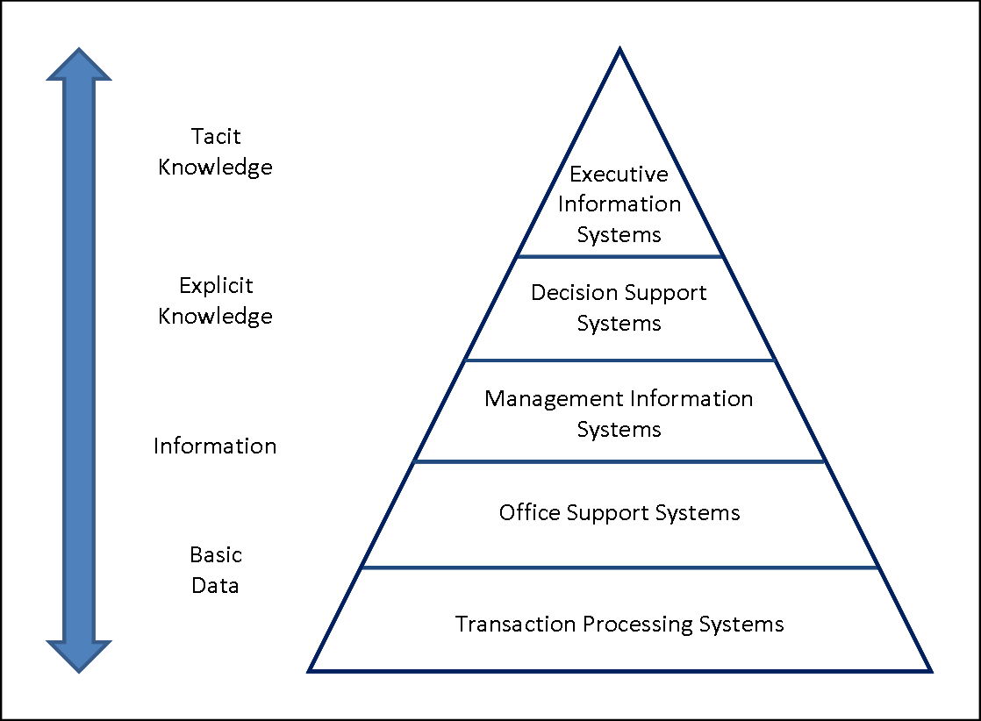
For information and discussion only
http://www.chris-kimble.com/Courses/World_Med_MBA/Types-of-Information-System.html

Slide 30
Understanding the Application Domain
Requirements Elicitation
To analyse requirements we must first understand the customer’s problem area
This is called the ‘problem’ or ‘application domain’
≡ the vocabulary of the client: the things manipulated by the business and the relationship between them
The problem domain for a college administrator might include students, researchers, lecturers, teachers, instructors, programmes, degrees, courses, modules, units, lectures, tutorials, seminars, colloquia, exams, tests, assessments
The problem domain for a games developer might include facets, sprites, texture, mesh skins, timeline scrubbing, blend trees, trajectories, transitions,…
The application domain in banking might include assets, debits, accruals, instruments, equities, stocks, shares, bonds, options, futures, derivatives, swap, trade, loan, amortize…
The problem domain for a molecular biologist might include nucleosides, nucleotides, oligonucleotides, polynucleotides, transcription and expression …

Slide 31
Requirements Elicitation – Domain Modelling
Requirements Elicitation
Finding the ‘things’ of interest in the application domain
Real-world objects and concepts that a system needs to keep track of
Student
Room
Lecturer
Business objects that represent things that are manipulated in a business
Programme
Course
Qualification
Timetable
Events that will or have transpired
Enrol
Graduate
Assign lecturer

Slide 32
Requirements Gathering – How? Fact Finding Techniques
Requirements Elicitation
Interviewing
Structured versus unstructured interviews
Questionnaires and surveys
Workshops
Scenario Analysis
Story boards, Trees…
Analysis of existing system
Documentation, forms analysis,
Observation/Video cameras
Prototyping
Mock-up or skeleton
Notes:
32

Slide 33
Workshops
Requirements Elicitation – Fact Finding
Facilitated workshop provides forum to exchange views and achieve consensus when need to make decisions, explore ideas and exchange knowledge to solve business problem.
Benefits
Speed: possible to achieve agreement in a day or two as opposed to weeks or months using traditional methods
Ownership: Stakeholders who are part of the group decision making are more likely to be committed
Productivity: better understanding of each other’s viewpoint misunderstanding can be swiftly clarified
Consensus: discussion can lead to common understanding
Quality of Decision-making: high level of confidence and understanding as stakeholders active players
Overall perspective: participants can appreciate importance of areas they are not directly involved
Problems
Cost and scheduling: getting dedicated time from busy people hard
Participants with hidden agendas

Slide 34
Workshop Roles
Requirements Elicitation – Fact Finding
Sponsor: ‘Owner’ of workshop and it’s objectives. Creates terms of reference with facilitator and empowers participants to make decisions
Facilitator: manages process NOT content, maintains focus and manages group dynamics. Must be professional, detached, positive, active listener, able to question and give feedback.
Participants: empowered to speak and make decisions on behalf of their areas
Scribe: accurately captures output and publishes as formal documentation.

Slide 35
Fact Finding - Interviewing
Requirements Elicitation – Fact Finding
The requirements team meet with the stakeholders to extract all relevant information
Two types of questions
Close-ended questions require a specific answer
Open-ended questions are asked to encourage the person being interviewed to speak out
Two types of interviews
In a structured interview, specific questions (prepared before hand) are asked, frequently close-ended
Notes:
35

Slide 36
Interviews in Practice
Requirements Elicitation
Normally a mix of closed and open-ended interviewing.
Interviews are good for getting an overall understanding of what stakeholders do and how they might interact with the system.
Interviews are not good for understanding domain requirements
Requirements engineers cannot understand specific domain terminology;
Some domain knowledge is so familiar that people find it hard to articulate or think that it isn’t worth articulating.
See notes on interviewing

Slide 37
Effective Interviewers
Requirements Elicitation
Interviewers should be open-minded, willing to listen to stakeholders and should not have pre-conceived ideas about the requirements.
They should prompt the interviewee with a question or a proposal and should not simply expect them to respond to a question such as ‘what do you want’.

Slide 38
Questionnaires and Surveys
Requirements Elicitation – Fact Finding
In addition to interviews
Close-ended questions
Multiple-choice questions
Rating questions
Ranking questions

Slide 39
Questionnaires
Requirements Elicitation
Careful design, be clear about purpose and disposition of info.
Care in choice of questions, don’t lead, ease of analysis
Care in administering, most people give low priority
Be aware of limitations

Slide 40
Interviews or Questionnaires?
Requirements Elicitation
People widely dispersed?
Large number of people?
Exploratory study?
Sampling opinion?
Problem sensing?
Whom to pursue further?

Slide 41
Ethics of Interviews and Questionnaires
Requirements Elicitation
Interviews and questionnaires maybe intrusive
Must have clear consent from interviewee
Maintain confidentiality and non-attribution
Limit objectionable or intrusive content
Avoid illegal content
Young or vulnerable interviewees

Slide 42
Examples of Activities that have Ethical Implications
Requirements Elicitation
Access to personal and/or confidential non-anonymised data without the identifiable participant’s specific consent.
Administration of procedures that may be harmful to participants either during or after the development process.
Development that involves contact with illegal activities, or investigation of identifiable participants involved in illegal activities.
Development involving individuals with a limited capacity to give informed consent (e.g. adults who are unconscious or very severely ill; adults with learning disabilities; adults with dementia, children).
Development having potential military/terrorist applications.
Publication of data that might allow identification of individuals.
Questionnaires or interviews where the contents might be perceived as being sensitive.

Slide 43
Fact Finding Cont’d - Observation
Requirements Elicitation – Fact Finding
Of working environment
Passive or Active
Could tape or video (permission)
Good for showing procedures, bottlenecks etc
Carried for a prolonged period of time
Can affect behaviour of the watched!

Slide 44
Observation
Requirements Elicitation
STROBE - Structured Observation of the Environment (Kendal & Kendal)
Office location, placement of the decision makers desk
Stationary, office equipment
Props, trade journals & newspapers
Office lighting & colour, clothing worn by decision maker etc

Slide 45
Study of Documents and Existing Software Systems
Requirements Elicitation
Use case requirements
Organizational documents
System forms and reports
Domain knowledge requirements
Domain journals and reference books

Slide 46
Fact Finding - Prototyping
Requirements Elicitation
Increasingly used to speed up requirements determination especially useful where user can’t articulate thier needs: IKIWISI (‘I’ll Know It When I See It’
Create demonstration system showing how a system might work (skeleton prototype) or how it might look (mock-up prototype)
Can be screen mock-ups or paper prototypes
Can support scenario analysis

Slide 47
Prototyping Cont’d
Requirements Elicitation – Fact Finding
Advantages
Helps user determine requirements – especially user interface, navigation paths…
Validates requirements
Reduce risk of ‘getting it wrong’
Disadvantages
Can run out of control
Can raise unrealistic expectations
Can lead user to overestimate progress

Slide 48
Scenario Analysis
Requirements Elicitation – Fact Finding
Essentially telling a story of a task or transaction
Analyst walks user through with ‘what if’ questions to ensure all paths covered
More when discussing ‘Use-Case’ analysis or Agile user stories.
Disadvantage – can be very time consuming.

Slide 49
Documenting Fact Finding
Systems are often complex
Difficult to see what is happening
Pictures and diagrams are useful and are used a lot in systems analysis
We will be looking at specific graphical languages for documenting and modelling systems later

Slide 50
Note Taking - Rich Pictures
An alternative to written notes
Use of drawings for gathering information and providing insight about a complex situation
Pre-analysis, before you have clear understanding of the problem – attempt to assemble everything the might be relevant
Guidelines:
No rules, use your instinct, do not impose style or structure
Avoid thinking in system terms or including system boundaries
Avoid too much writing
Checkland, P., Poulter, J. (2006) Learning for Action: A Short Definitive Account of Soft Systems Methodology and its use for Practitioners, Teachers and Students, Wiley

Slide 51
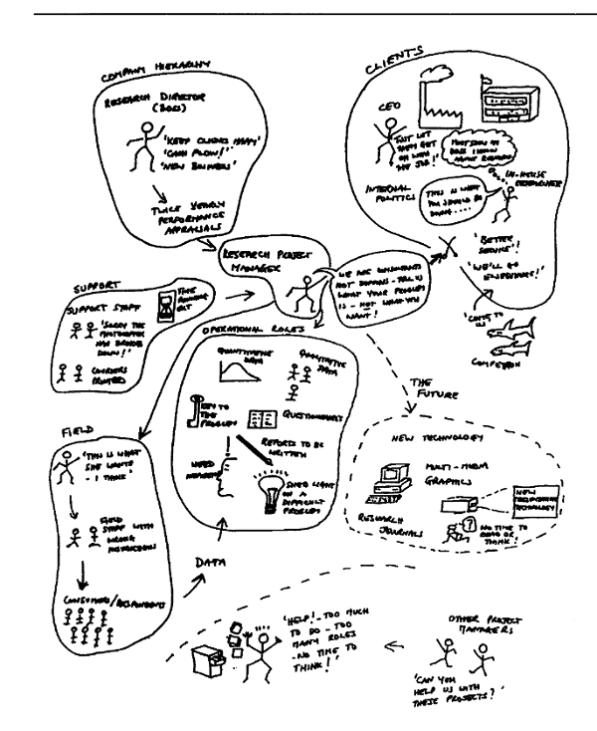
Rich Pictures Example 1
Example from Brocklesby, J., Using soft systems methodology to identify competence requirements in HRM, International Journal of Manpower, V16(5/6):70-84

Slide 52
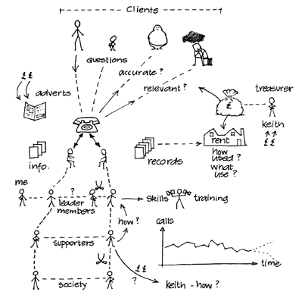
Rich Pictures Example 2
From The Open University, Systems Thinking and Practice, Rich Pictures, http://systems.open.ac.uk/materials/T552/pages/rich/richAppendix.html

Slide 53
What requirements we capture
Requirements Elicitation
Functional Requirements (to do with the business)
Non-functional Requirements (platforms, performance, constraints)
What does the system need to do?
How does the system need to do it?
This will be discussed further when looking at requirements specification next week

Slide 54
Requirements Engineering
Inception
Requirements Elicitation
Requirements Analysis
Requirements Specification
Requirements Validation
Requirements Management

Slide 55
Requirements Analysis
Determining whether the stated requirements discovered through consultation with stakeholders are clear, complete, consistent and unambiguous, and resolving any apparent conflicts.
Exercise: Consider the following requirement:
“The system will:
(i) provide facilities to change student’s personal details online. It should be quick and easy to use with a pleasant user interface.”
Is it clear, complete, unambiguous?
Is it verifiable, could you design and build system and check the system meets this specification? Do you need to do some more requirements gathering?
Prioritise Requirements

Slide 56
Requirements Analysis - Prioritising
Requirements Analysis - Prioritising
Check are the requirements
Essential
Desirable
Optional?
If choosing between options weight the requirements and evaluate

Slide 57
Requirements Analysis MoSCoW method for prioritising
Must include
Should include
Could include
Would be nice to include in future release

Slide 58
Summary - The Requirements Engineering Process
Requirements elicitation and analysis
Inception /
Feasibility study
Requirements specification
Feasibility report
Requirements validation
System models
User and system requirements
Requirements document

Slide 59
Summary - Requirements Engineering
The goal of the requirements stage is to accurately collect the client’s needs and document what is required from the proposed system in a requirements specification.
Requirements Engineering involves:
Inception - Feasibility
Requirements Elicitation
Fact finding and domain modelling
Requirements Analysis
Check for clarity, consistency and completeness
Prioritise (e.g. MoSCoW)
Requirements Specification
Formally document requirements
Requirements Validation
Requirements Management
Note: Validation and Management are included here for completeness but are not part of the System Building course

Slide 60
Questions?

